Slide 1

Topic: Virtual Memory
Lecture: Dr. Zhao Jie
Date: 02/23/2026

Slide 2
Reading Assignment
Chapter 13 and 14

Slide 3
Agenda
The Evolution of Memory Design
Memory Abstraction
Virtual Memory Components
Virtual Memory Address

Slide 4
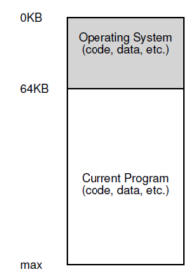
OS: The early days
The OS was a set of routines (a library, really) that sat in memory (starting at physical address 0 in this example)
There would be one running program (a process) that currently sat in physical memory (starting at physical address 64k in this example).
The rest of the memory is left for the new usage.

Slide 5
Multiprogram and time-sharing
Over time, as machines became more expensive, people began to think about multiprogramming, in which multiple processes were ready to run simultaneously, and the OS would switch between them.
Time-sharing originated from the limitations of batch computing.
One way to implement time sharing would be to run one process for a short while, giving it full access to all memory (as in Figure 13.1), then stop it, save all of its state to some kind of disk (including all of physical memory), load some other process’s state, run it for a while, and thus implement some crude sharing of the machine.
Unfortunately, this approach has a significant problem: it is extremely slow, particularly as memory usage increases. While saving and restoring register-level state (e.g., the PC, general-purpose registers) is relatively fast, saving the entire contents of memory to disk is extremely non-performant. Thus, what we’d rather do is leave processes in memory while switching between them, allowing the OS to implement time-sharing efficiently

Slide 6
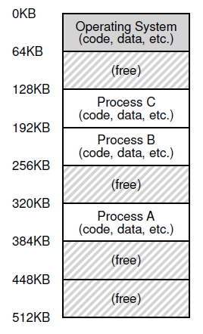

Residence of all processes in the memory
Residence of all processes in the memory is necessary.
- Swapping the processes between the memory and the hard disk is too slow.
However, the residence of all processes in the memory brings a challenge.
- Since the occurrence of the processes is random, the allocation of processes to memory space is not sequential. Thus, the processes are not consecutive. This makes the memory not easy to use. Nobody wants to remember the arbitrary memory address.

Slide 7
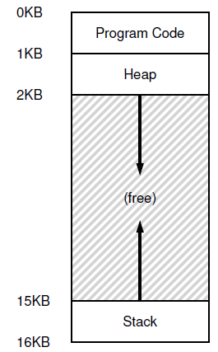

Abstraction: (Virtual) Address Space - 1
As the processes allocated physical memory is not consecutive, (virtual) address space is introduced.
Address space: abstraction of physical memory
Every process assumes it has access to a large space of memory from 0 to a MAX
CPU issues loads and stores to virtual addresses

Slide 8
Abstraction: (Virtual) Address Space - 2
The address space of a process contains all of the memory state of the running program.
For example, the code of the program (the instructions) have to live in memory somewhere, and thus they are in the address space.
The program, while it is running, uses a stack to keep track of where it is in the function call chain as well as to allocate local variables and pass parameters and return values to and from routines.
Finally, the heap is used for dynamically-allocated, user-managed memory, such as that you might receive from a call to malloc() in C or new in an object oriented language such as C++ or Java.

Slide 9
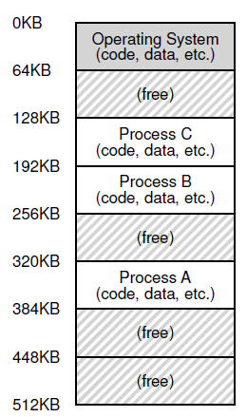
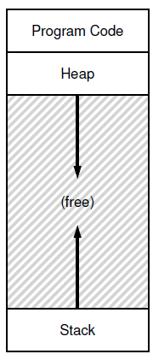
How is actual memory reached?
Address translation from virtual address (VA) to physical address (PA)
--- CPU issues loads/stores to VA, but memory hardware access PA
OS allocates memory and tracks the location of processes
Translation done by memory hardware called Memory Management Unit (MMU)
--- OS makes the necessary information available

Slide 10
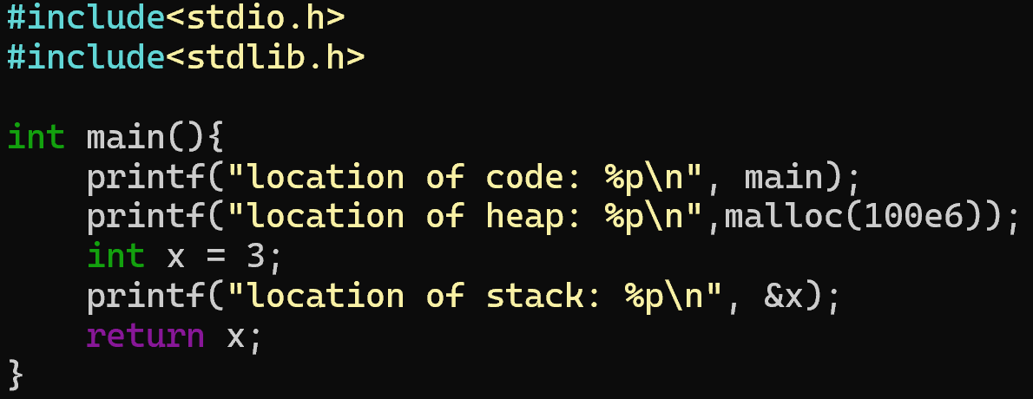
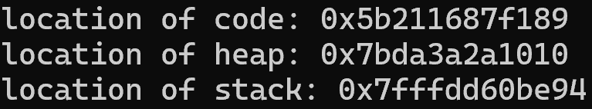
An example
Question: What are the outputs? Are there physical or virtual memory addresses?
Outputs:

Slide 11
Checking the memory map of a process - 1
The pmap command in Linux is a powerful utility used to display the memory map of a process.
Syntax

Slide 12
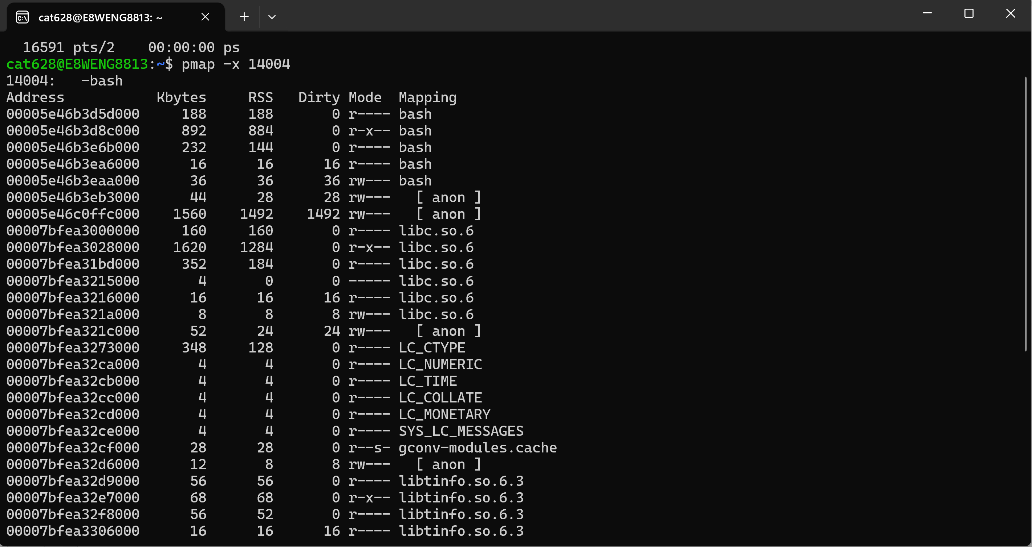
Checking the memory map of a process - 2
Example, -x
This option displays the memory map in an extended format, which provides additional details such as the resident memory size (RSS), shared memory size, private memory size, and more.

